Slide 1


Welcome to Third Grade!
Mr. Beckenstein

Slide 2
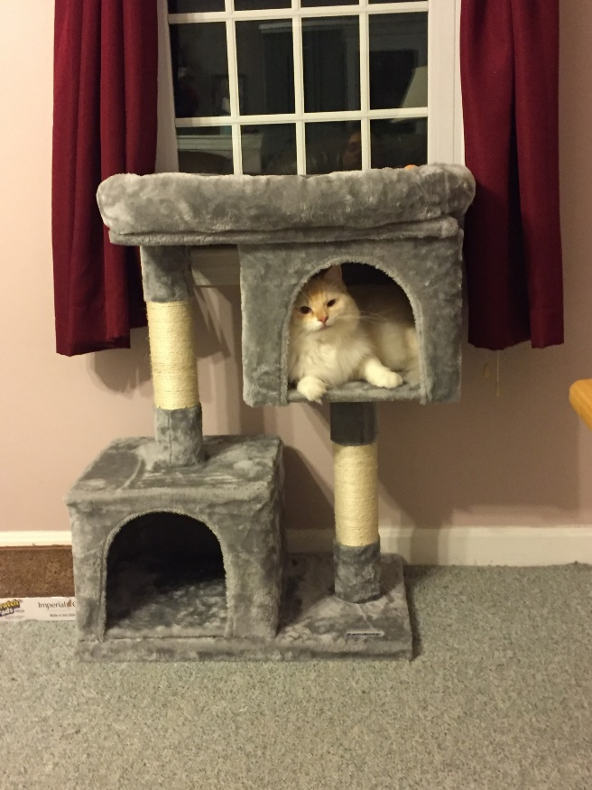
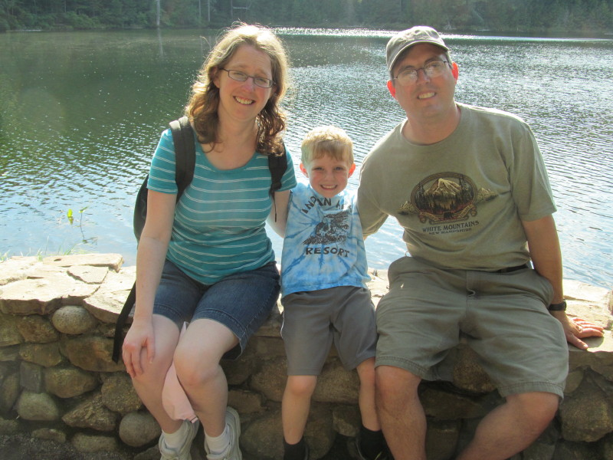
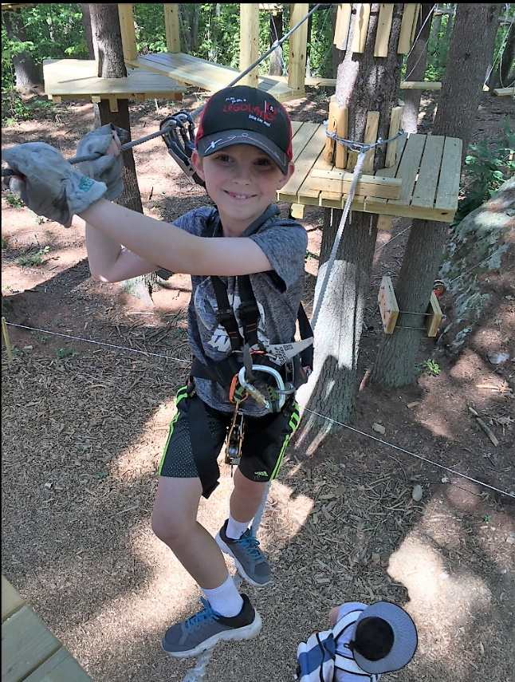
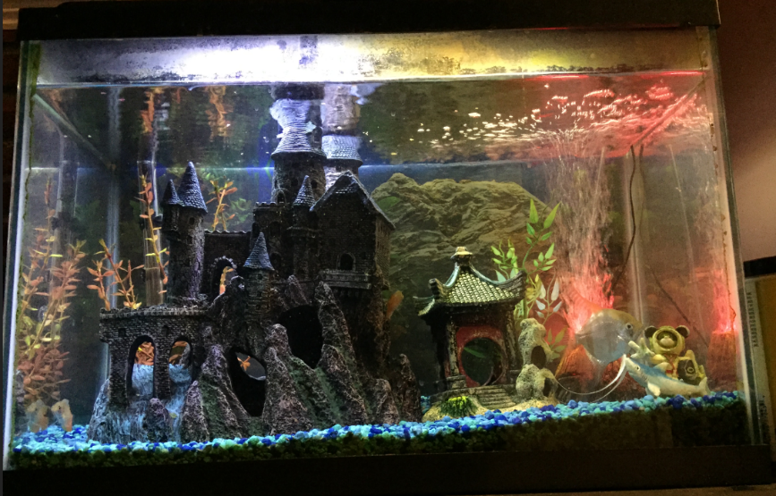
Welcome!
David
Fluffy

Slide 3



I have been teaching at the Igo Elementary School since 1997.
Teaching is my PASSION!
My goal is to create a classroom community where children are excited to learn!
What It Looks & Sounds Like
Where a child feels comfortable to take risks.
We celebrate our mistakes – “Teachable Moments”
We take the time to share ideas - “Turn & Talk”

Slide 4
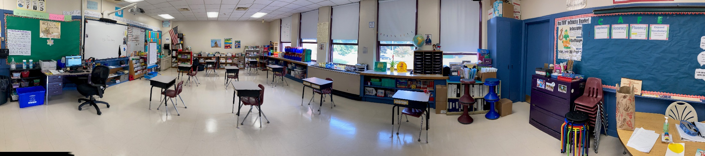
Tour Our Classroom!
Click on the photo below to take a virtual tour of our classroom!

Slide 5
Our Hybrid Model - A.M Cohort
Students will start the day in class with teacher at 8:45.
Students will receive math and literacy instruction from 8:45-11:15 with a 10 minute nut free snack/mask break.
Students will be dismissed at 11:15.
Students will arrive home for a break/lunch and begin their remote learning at 12:30.
At-Home-learning will be assigned electronically through CLEVER, however the first three weeks will be mostly paper and pencil, as we await our new devices. The AM students will receive their At-Home Learning Schedule on Monday.

Slide 6
Our Hybrid Model - P.M Cohort
Start the day in class by logging on to Webex for our morning meeting at 9:00. Remote students are encouraged to join.
At-Home-Learning part of the day begins after the morning meeting and ends at 11:15. At-Home-learning will be assigned electronically through CLEVER, however the first three weeks will be mostly paper and pencil, as we await our new devices.
The PM students will receive an At-Home-Learning schedule on Friday (so they will be prepared for the next Monday morning).
Students will have lunch at home and will arrive at school at 12:30
Students will receive math and literacy instruction from 12:30-3:00 with a 10 minute nut free snack/mask break.
Students will be dismissed at 3:00

Slide 7

We Are Flexible!
Until students receive their personal devices, we understand that students may not have access to devices and may need to share devices with siblings. Paper and pencil assignments will be sent home as much as possible in the meantime!
However, At-Home-Learning work is not optional. It is expected that students complete all of their assignments during the remote portion of their day.

Slide 8
For the remote part of the school day, students should have a workspace at home with the following materials:
A PENCIL
Students will be given an ELA Bag and a Math Bag. These bags are to stay at home. Everything they need to complete their assignments should be in their bags ☺.

Slide 9

Reader’s Workshop
Student self-selected text, picture books, non-fiction text and poetry; grammar, spelling, word study, and writing
Literacy includes read-aloud, shared reading, guided reading,
and independent , sustained reading.
Children respond In their reader response journals daily.
Transition from learning to read to
reading to learn

Slide 10
Writer’s Workshop
3 Domains of Writing
  Narrative
  Informative
  Persuasive
Writer’s notebooks – Children learn to write
like authors
Across the curriculum content areas

Slide 11
Math Workshop
Targets instruction, while allowing choice time and guided math time with teachers and peers
Focus on problem-solving, “Showing Your Thinking” (pictures, numbers, words), and math talk.
Allows time for reflection
Encourages a growth-mindset attitude
Based on strategy instruction and ability of students
to think flexibly, understand, and problem solve
Fact Fluency Homework Addition & Subtraction facts mastered and Multiplication and Division facts up to 10 x 10

Slide 12


Science & Social Studies
Tasks will be completed during the At-Home-Learning part of the day.
Freckle and Buzz will be used to assign student work.
More details coming soon!!

Slide 13
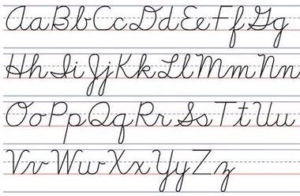
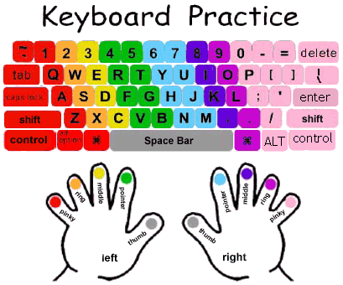
Cursive and Typing
We do learn cursive in third grade! The goal for every student is to learn how to write his or her signature ☺.
We also have a new typing program called typingclub.com!

Slide 14

Homework
Handbook Guidelines = 30 minutes
15-20 minutes of independent/shared reading per night
Math fact fluency games each week or Word Work for 10 minutes

Slide 15


The Power of
YET!
We are here to learn. Don’t feel discouraged when you come across something that is hard. Learning is a “messy” business. We make mistakes, but we don’t give up!
I CAN’T do this! Change your MINDSET I can’t do this…YET!
I’ll give it my best try!

Slide 16
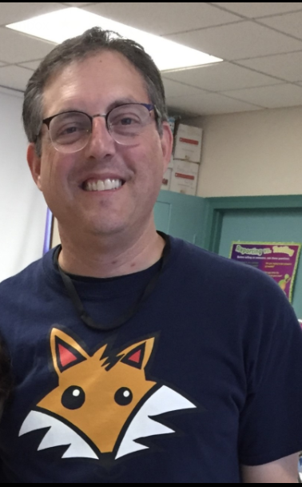
Visit our class website often for updates: https://mrb210.weebly.com/
Email me with any questions or concerns to beckensteinb@foxborough.k12.ma.us

Slide 17

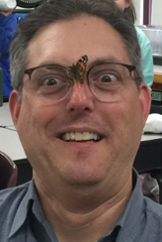
Our Classroom Motto!

